Slide 1


[COUNTRY, YEAR]
Qualitative Data Collection

Slide 2
[NOTE:
TRAINING COORDINATORS SHOULD ADAPT THIS MODULE BASED ON THE SKILLS AND EXPERIENCE OF INTERVIWERS HIRED TO CONDUCT THIS COMPONENT OF THE STUDY. MORE OR LESS INTRODUCTORY AND BEST PRACTICE INFORMATION MAY BE REQUIRED]
Notes:
Include any details related to your organization’s data collection protocols.

Slide 3
Activity: Qualitative interviews
What are qualitative interviews?
Notes:
A: Technique to learn how a person thinks and feels about a topic​
Technique to learn how a person thinks and feels about a topic​
Participant is the expert!​
Usually one-on-one​
Open-ended questions​
Probe responses for depth​
Conversation-like​
Rapport is critical​

Slide 4
What is a qualitative interview?​
Technique to learn how a person thinks and feels about a topic​
Participant is the expert!​
Usually one-on-one​
Open-ended questions​
Probe - for depth​
Conversation-like​
Rapport is critical​

Slide 5
Getting “rich” information​
Develop good rapport with participant​​
Active listening​​
Make participant feel that they are the expert ​​
Others?
Information is “rich” when participant gives lots of detail – this is what we want!
Make it clear – they’re allowed to be critical. ​​
How can you make this happen? ​​
Notes:
- As you know, it’s critical to get rich information for qualitative interviews
- And information is rich …
Make it clear that they’re allowed to be critical--- safe space – consultants didn’t develop the tool (independent)– we really do want to know how to improve, really important to this study. Data collectors – not judgmental and really want to hear feedback.

Slide 6
Activity
What are key elements of interviewing skills?
Notes:
A: Building rapport, active listening, probing

Slide 7

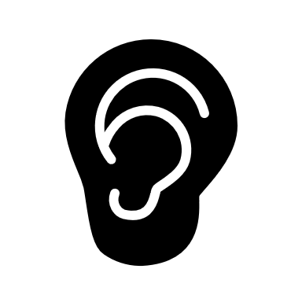

Interviewing skills​
Building
rapport
Active
listening
Probing
Notes:
- Some of the key elements of good interviewing skills include:
Build a god rapport (or impression) with the interviewee
Active listening
Probing – natural questions to get interviews to elaborate on their answers
- We’ll dive into each one in the following slides.

Slide 8

Activity
What are some ways to build rapport (positive impressions)?
Notes:
A: dress respectfully, look interested, maintain eye contact

Slide 9
1. Building rapport
Participant’s impression of the interviewer is based on the greeting, manner of speaking, clothing, and body language​​.
Speak and dress respectfully​​
Look interested​​
Maintain eye contact (without staring at the respondent​​)
Position yourself in a way that puts you on equal footing with participant​

Slide 10
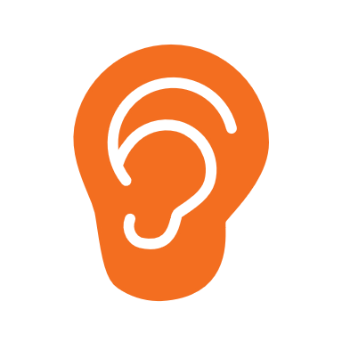
Activity
What are some strategies to show active listening?
Notes:
A: Eye contact, reinforce speaker, move smoothly between topics

Slide 11
2. How to show we are listening​
Make eye contact & have open and relaxed body language​ | Reinforce the speaker | Move smoothly between topics​
Avoid: Crossing your arms Turning away from the speaker Playing with your phone Fidgeting​ | Repeat key ideas & summarize what has been shared with you. Helps clarify what the interviewee is sharing Helps them feel heard | Don’t move the participant forward before she/he is ready. If you need to move on for the sake of time ----“Thank you, for what you have been sharing, I’d like to be respectful of your time and would like to keep moving through the interview.”

Slide 12
IDI Active Listening
Best practices:
Paraphrase and summarize: Repeat back what you've heard in your own words, ensuring understanding.
Reflect emotions: Acknowledge and validate the participant's emotions.
Ask open-ended questions: Encourage detailed responses with questions starting with what, how, or why.
Avoid interrupting: Let the participant finish speaking before responding.

Slide 13
IDI Active Listening
Best practices:
Show empathy: Demonstrate understanding and compassion.
Take notes: Record key points while maintaining eye contact.
Use nonverbal cues: Lean forward, use open body language, and show interest.
Clarify and probe: Seek additional information and clarification when needed.

Slide 14
2. Active listening
Without it, you may miss:​
Opportunities to probe​
New ideas that haven’t been discussed in previous interviews​
Listening is a skill:​
Need to train ourselves to listen ​
Hear what people are saying​
Don’t make assumptions that you understand what someone is saying​

Slide 15
Activity
What are some phrases to verify unclear responses?
Notes:
As part of active listening ----
A: I’m sorry, can you repeat what you said?

Slide 16
2. Verify unclear responses​
By asking respondent to repeat what she said:​
“I’m sorry, could you repeat what you just said? I didn’t quite hear you.”​
By reflecting the answer back to the participant: ​
“So what I am hearing is…”​

Slide 17

Activity
What are probes? What are some examples of ways to probe?
Notes:
Next we’re doing to move onto probes --- starting with an questions. How do you define probes? What are some examples of ways to probe?
A: Neutral questions/phrases

Slide 18
3. probing
Neutral questions, phrases, sounds or gestures​ - used to encourage participants to elaborate on their answers and explain why or how​
Direct questions:
• “What do you mean when you say . . .?”
• “Why do you think . . .?”
• “How did this happen?”
• “How did you feel about . . .?”
• “What happened then?”
• “Can you tell me more?”
• “Can you please elaborate?”
• “I’m not sure I understand X. . . .Would you
explain that to me?”
• “How did you handle X?”
• “How did X affect you?”
• “Can you give me an example of X?”
Indirect probes:
• Neutral verbal expressions ---“uh huh,”
“interesting,” and “I see”
• Verbal expressions of empathy, such as, “I can see why you say that was difficult for you”
• Mirroring technique, or repeating what the
participant said, such as,“ So you received your first vaccine in 2021. . .”
• Culturally appropriate body language or
gestures, such as nodding in acknowledgment
Notes:
Probing is …
Some examples of direct probing questions are …..
Some examples of direct probing (sounds or gestures) are ….

Slide 19
3. Probing
​Probing is key to a rich, useful interview​:
Assumes you are listening​
Assumes you understand what type of information you need ​
Communicate interest to the participant​
Allows you to clarify things you don’t understand​
But: Need to be able to read when to back off & avoid interrupting or over controlling​ through probes.
Notes:
Its important to remember is key to a rich and useful interview because it …

Slide 20
3. Probing
Balance following the guide and knowing when to dive deeper into certain responses.
Be natural and avoid going through the guide robotically
Ask follow-up and clarifying questions when you don’t understand – using techniques from previous slides
Notes:
Also remember

Slide 21
3. Probing
Probing techniques help gather richer, more detailed data, and ensure you understand the participant's perspectives accurately.
Contrast probing: Ask about differences or similarities between ideas or experiences.
Emotional probing: Explore emotions related to the topic, asking how they felt or why.
Causal probing: Investigate causes or effects, asking why or how something happened.
Probing for specifics: Ask for details, such as times, dates, or quantities.
Probing for extremes: Ask about the best, worst, or most significant experiences related to the topic.
Probing for metaphors: Ask participants to describe complex concepts using metaphors or analogies.
Silence: Use strategic silence to encourage participants to share more information.

Slide 22
3. Probing
Probing techniques help gather richer, more detailed data, and ensure you understand the participant's perspectives accurately.
Probing practice. How would you probe for more information after each of these answers?
Q. “Are there any means of cooperation between companies at your level?
A. “Yes, some”
Probe:
Q. “How do you determine the selling price of [antimalarial or RDTs]?”
A. “We just add a markup to what we paid for them”
Probe:
Notes:
1. Potential probes: Can you give me a specific example of how you've cooperated with another company recently? Is this cooperation mostly with companies in your immediate area, or does it extend beyond your region?
2. Potential probes: Can you tell me more about how you decide on that markup percentage? Is it the same for all products, or does it vary between antimalarials and RDTs? Do you also factor in things like shipping costs, storage, or staff time?

Slide 23

[Country, Year]
End of session
Thank you for your attention!
Any questions?

